Slide 1
What tenses are these in English? Read and say.
She likes cars And he likes bikes. And she doesn't like long hikes. And he doesn't like long walks. And I don't like boring talks. Do you like it? Yes, I do! I'm honest. It is true! Does he like it? Yes he does! He likes everything but cars!
I am counting to ten,
You are giving them a pen,
She is looking at the door,
He is sitting on the floor,
All of us are working well,
Waiting, waiting for the bell.
Present Simple
Present Continuous

Slide 2
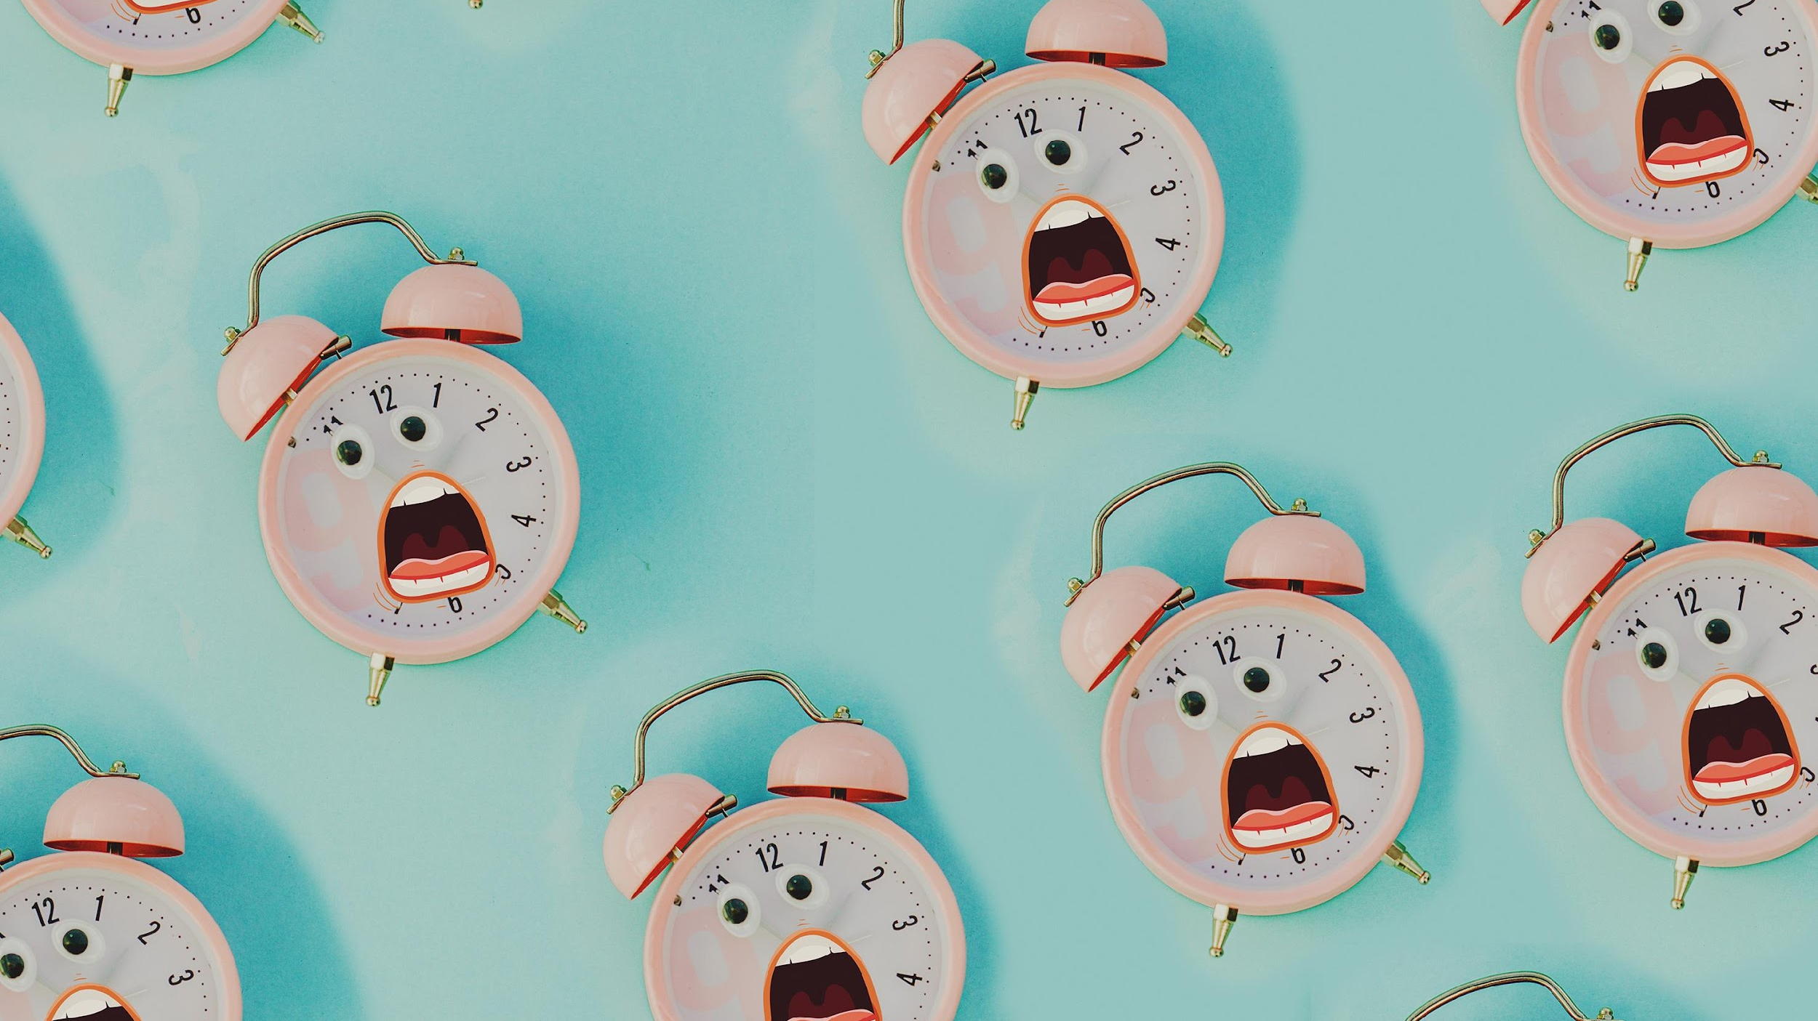
PRESENT SIMPLE VS PRESENT CONTINUOUS

Slide 3
THEORY

Slide 4
PRESENT SIMPLE
We use Present Simple to talk about:
Permanent situations or states
General truths and laws of nature
Repeated / habitual actions
Timetables
Key words: always, usually, often, sometimes, never, every day\week\month\year

Slide 5
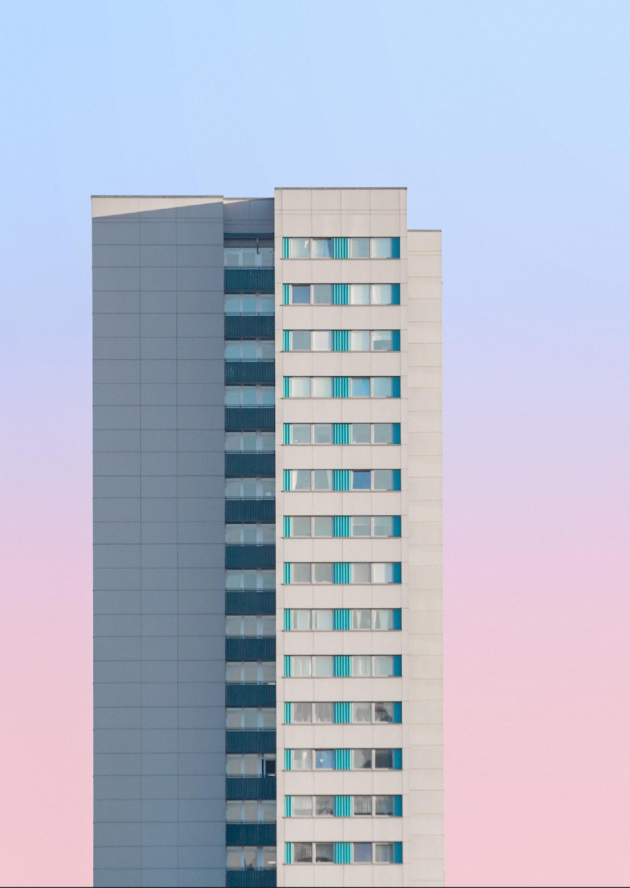
1. PERMANENT SITUATIONS OR STATES
He works in a large office building.
My mother has blond curly hair and big blue eyes.

Slide 6
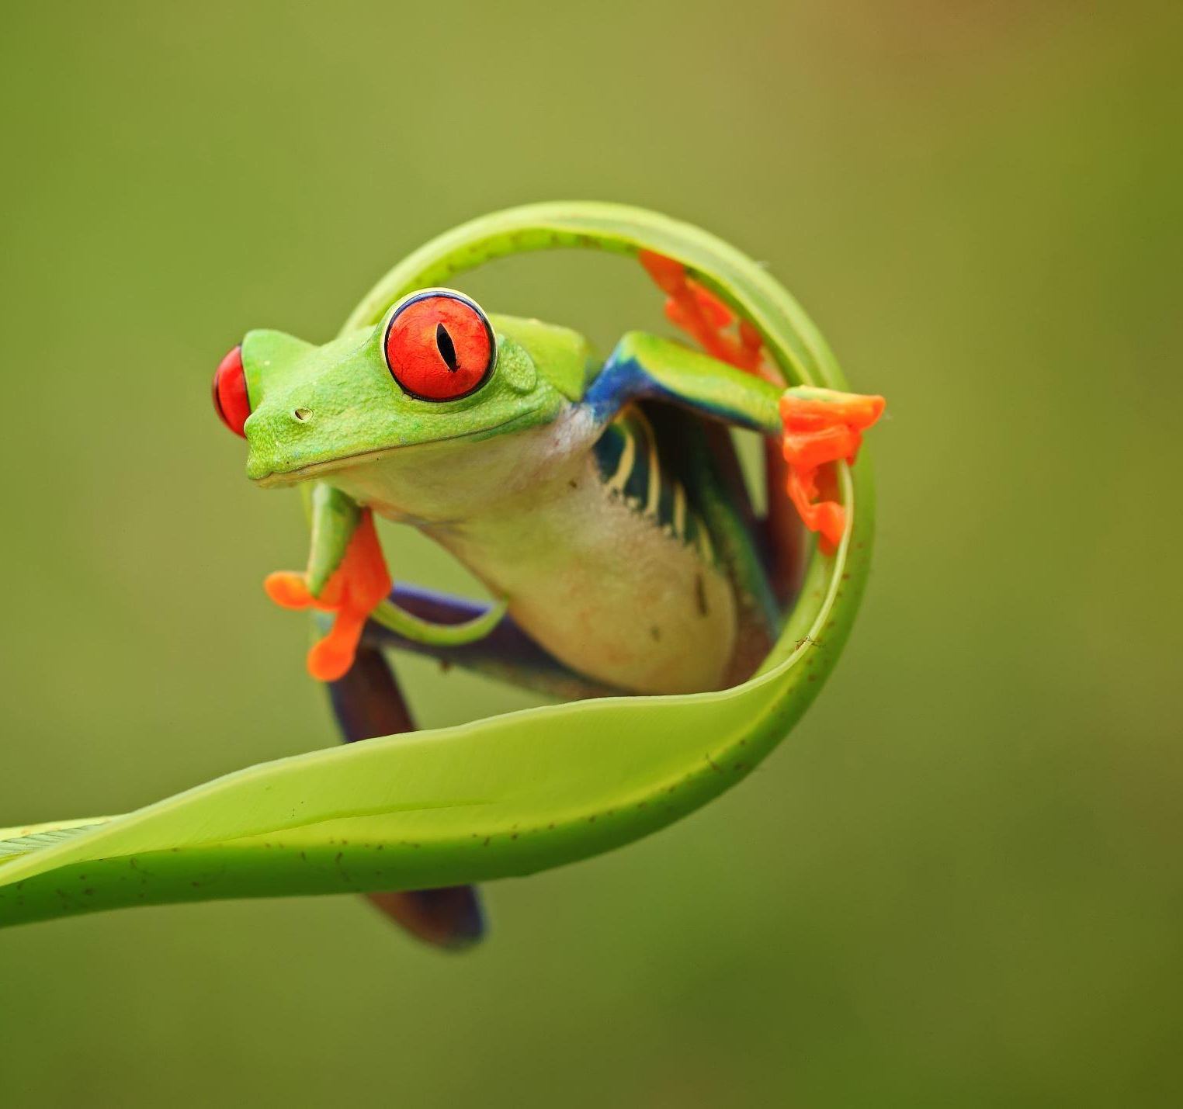
2. GENERAL TRUTHS AND LAWS OF NATURE
Water boils at 100 degrees Celsius.
Everybody goes to school when they are young.

Slide 7
3. REPEATED / HABITUAL ACTIONS
He always does his homework.
Moscow never sleeps.

Slide 8
4. TIMETABLES
The race starts at 3pm.
Our flight takes off at half past seven.

Slide 9
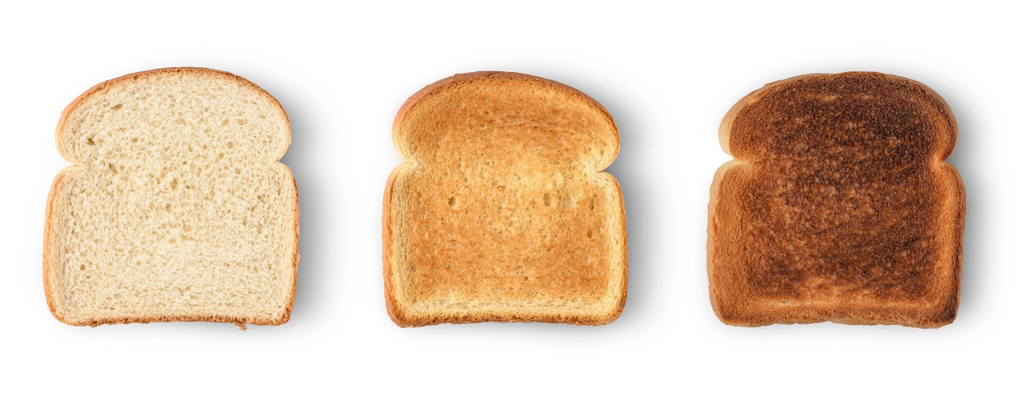
PRESENT CONTINUOUS
We use Present Continuous to talk about:
Temporary situations
Actions happening at or around the moment of speaking
Fixed arrangements in the near future
Key words: now, at the moment, right now, today, these days, Look!, Listen!.

Slide 10
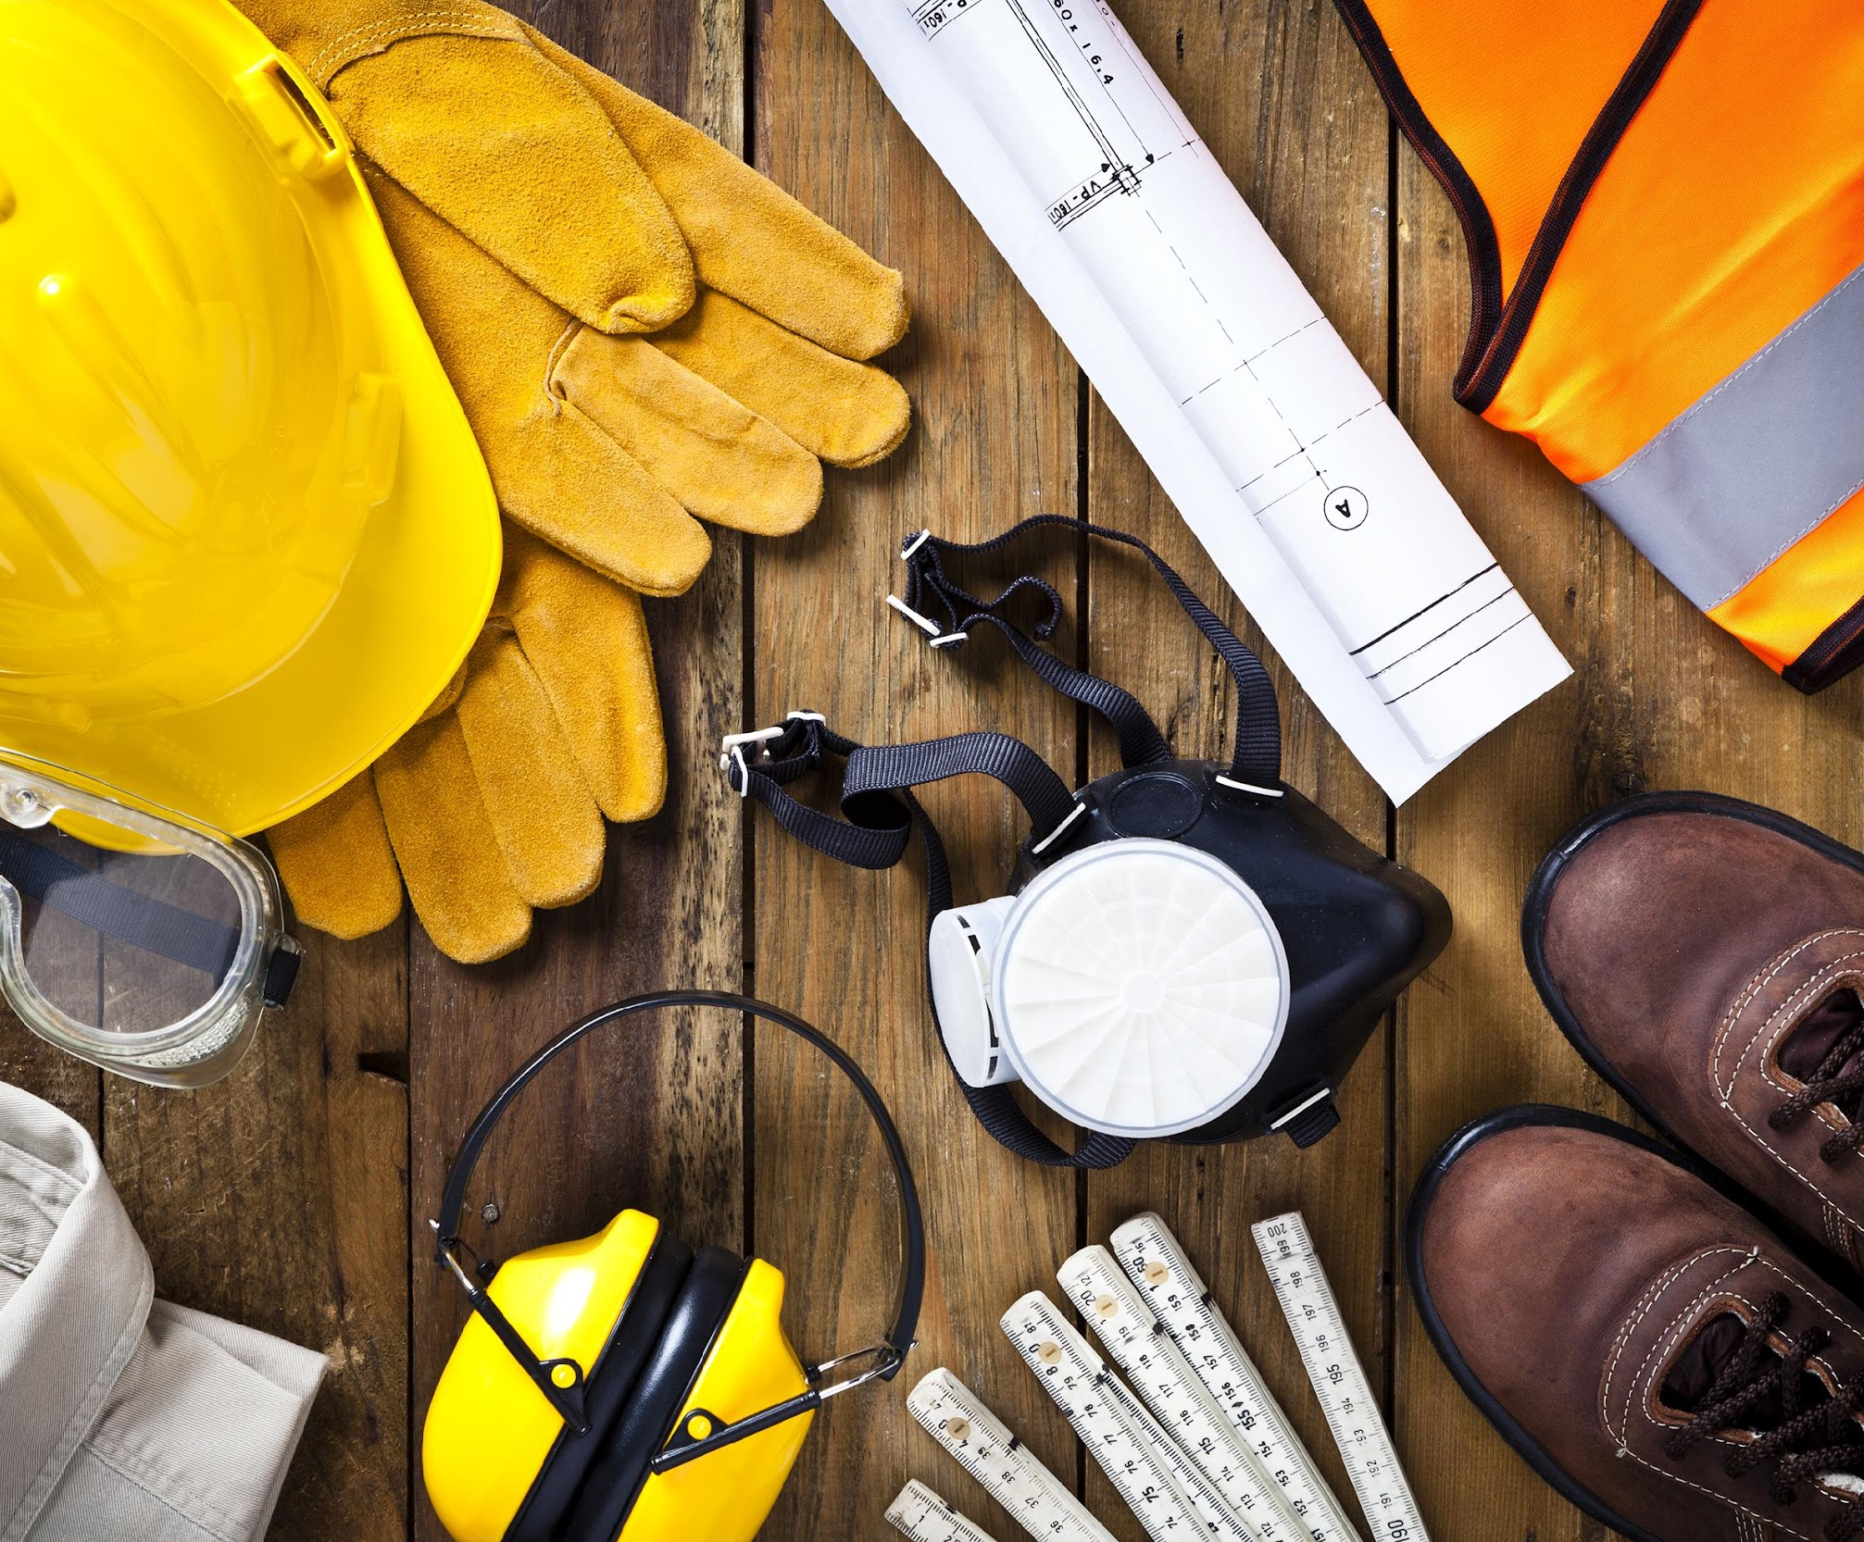
1. TEMPORARY SITUATIONS
She is working in Paris this week.
Russell is writing his new essay.

Slide 11
2. ACTIONS HAPPENING AT OR AROUND THE MOMENT OF SPEAKING
Jessica is playing the piano at the moment.
My mum is staying at my place for a few weeks.
What are you reading right now?

Slide 12
3. FIXED ARRANGEMENTS IN THE NEAR FUTURE
Are you meeting with John this Friday?
We are having a visit on Monday.

Slide 13
PRESENT SIMPLE VS PRESENT CONTINUOUS
Present Simple
Permanent situations or states
General truths and laws of nature
Repeated / habitual actions
Timetables / programs
Present Continuous
Actions happening at or around the moment of speaking
Fixed arrangements in the near future
Temporary situations

Slide 15
LET’S PRACTICE

Slide 16
always
now
sometimes
at the moment
every
right now
usually
today
often
never

Slide 17
cook
am cooking
runs
is running
plays
is playing
decorate
are decorating
drive
are driving
bakes
is baking
watch
are watching

Slide 18
Translate the sentences into English.
1.Моя сестра слушает музыку каждый день.
2.Они всегда носят джинсы и футболки на прогулку.
3.Они играют в футбол в данный момент.
4.Мой папа работает в банке.
5.Она читает интересную книгу прямо сейчас.
6.Он часто ходит в кинотеатр с друзьями.
7.Послушай! Она по`n мою любимую песню.
8.Я пью чай в кафе сейчас.

Slide 19
Present Simple vs Present Continuous
TEST
Select the correct verb form
to complete each sentence.

Slide 20
1. She ______ TV every evening.
watches
is watching
A
C
watching
watch
B
D

Slide 21
2. The kids ______ outside at the moment.
is playing
plays
A
C
play
are playing
B
D

Slide 22
3. He ______ a fascinating book these days.
read
is reading
A
C
is read
reads
B
D

Slide 23
4. I usually ______ coffee in the morning.
drink
drinks
A
C
drinking
am drinking
B
D

Slide 24
5. She ______ at a supermarket.
is working
working
A
C
work
works
B
D

Slide 25
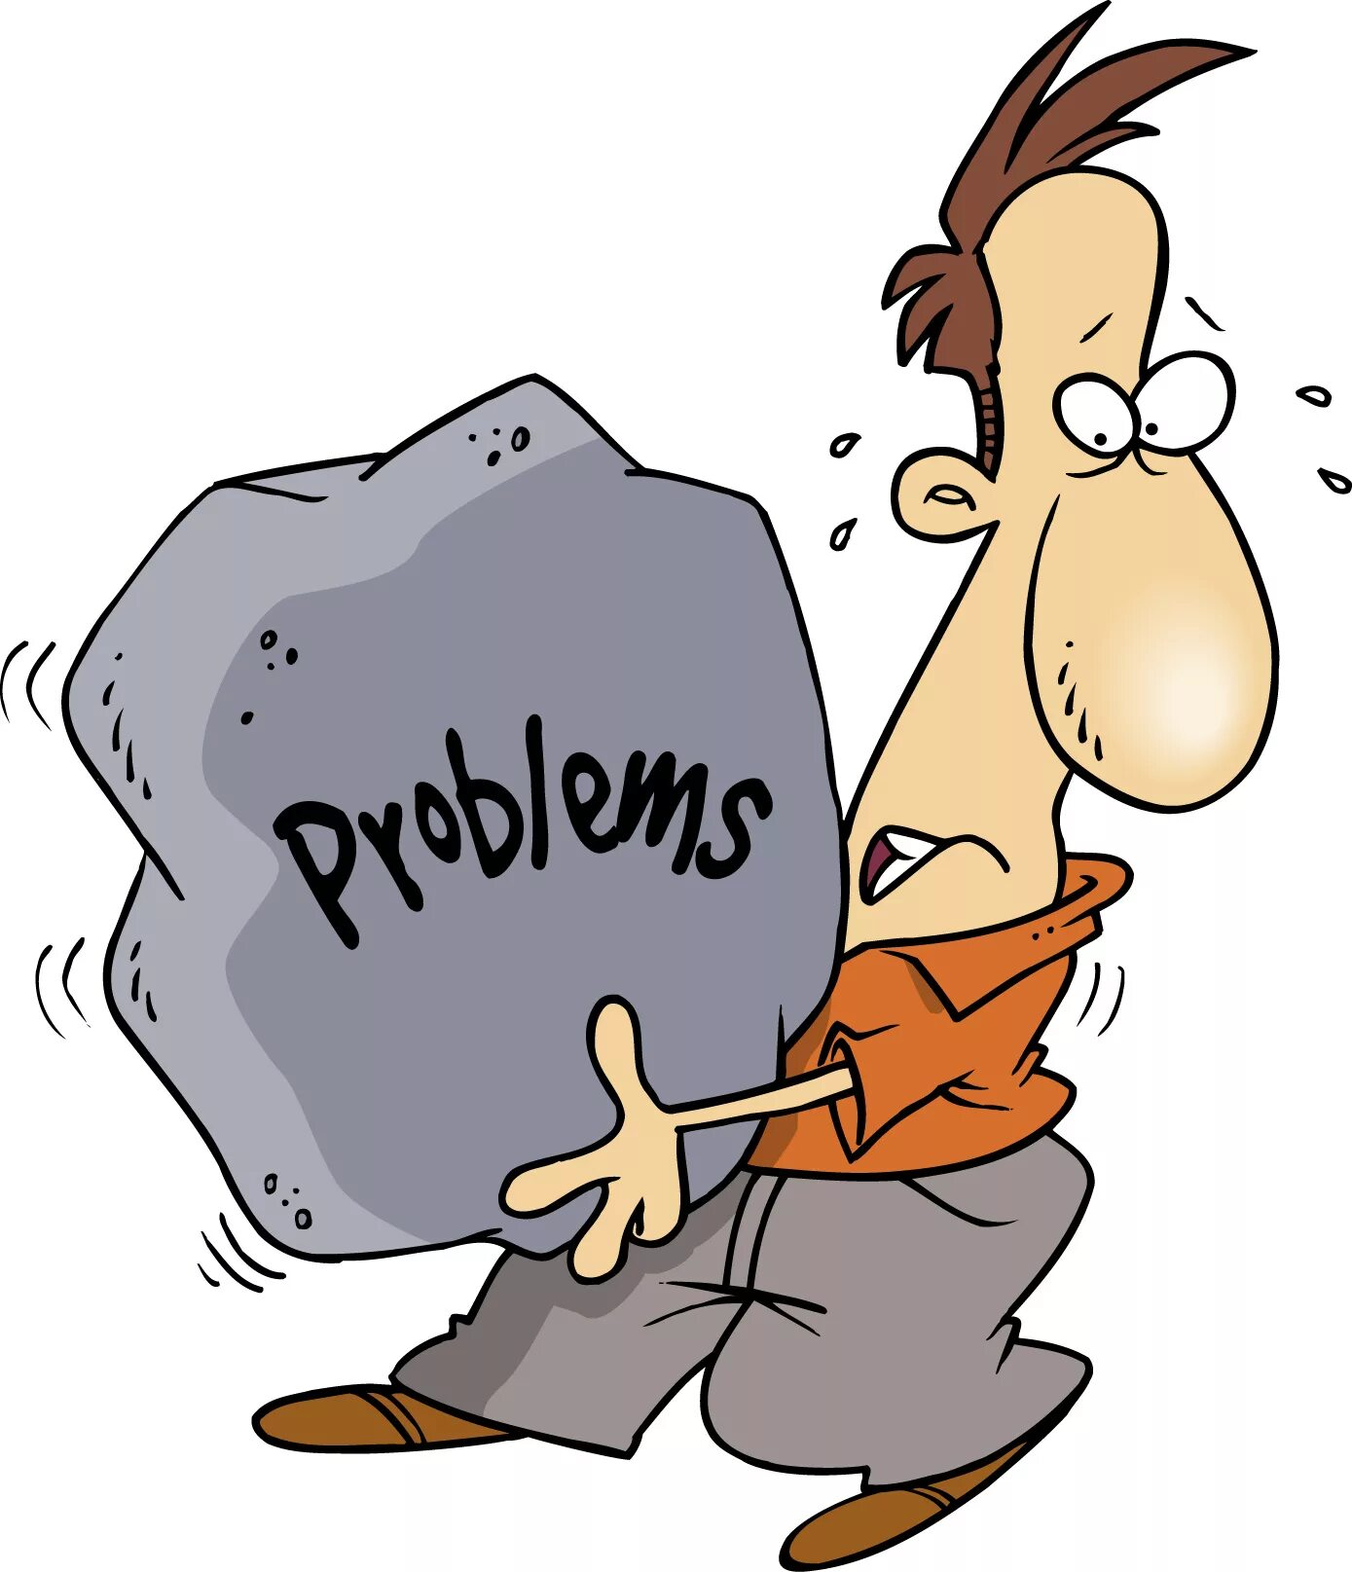
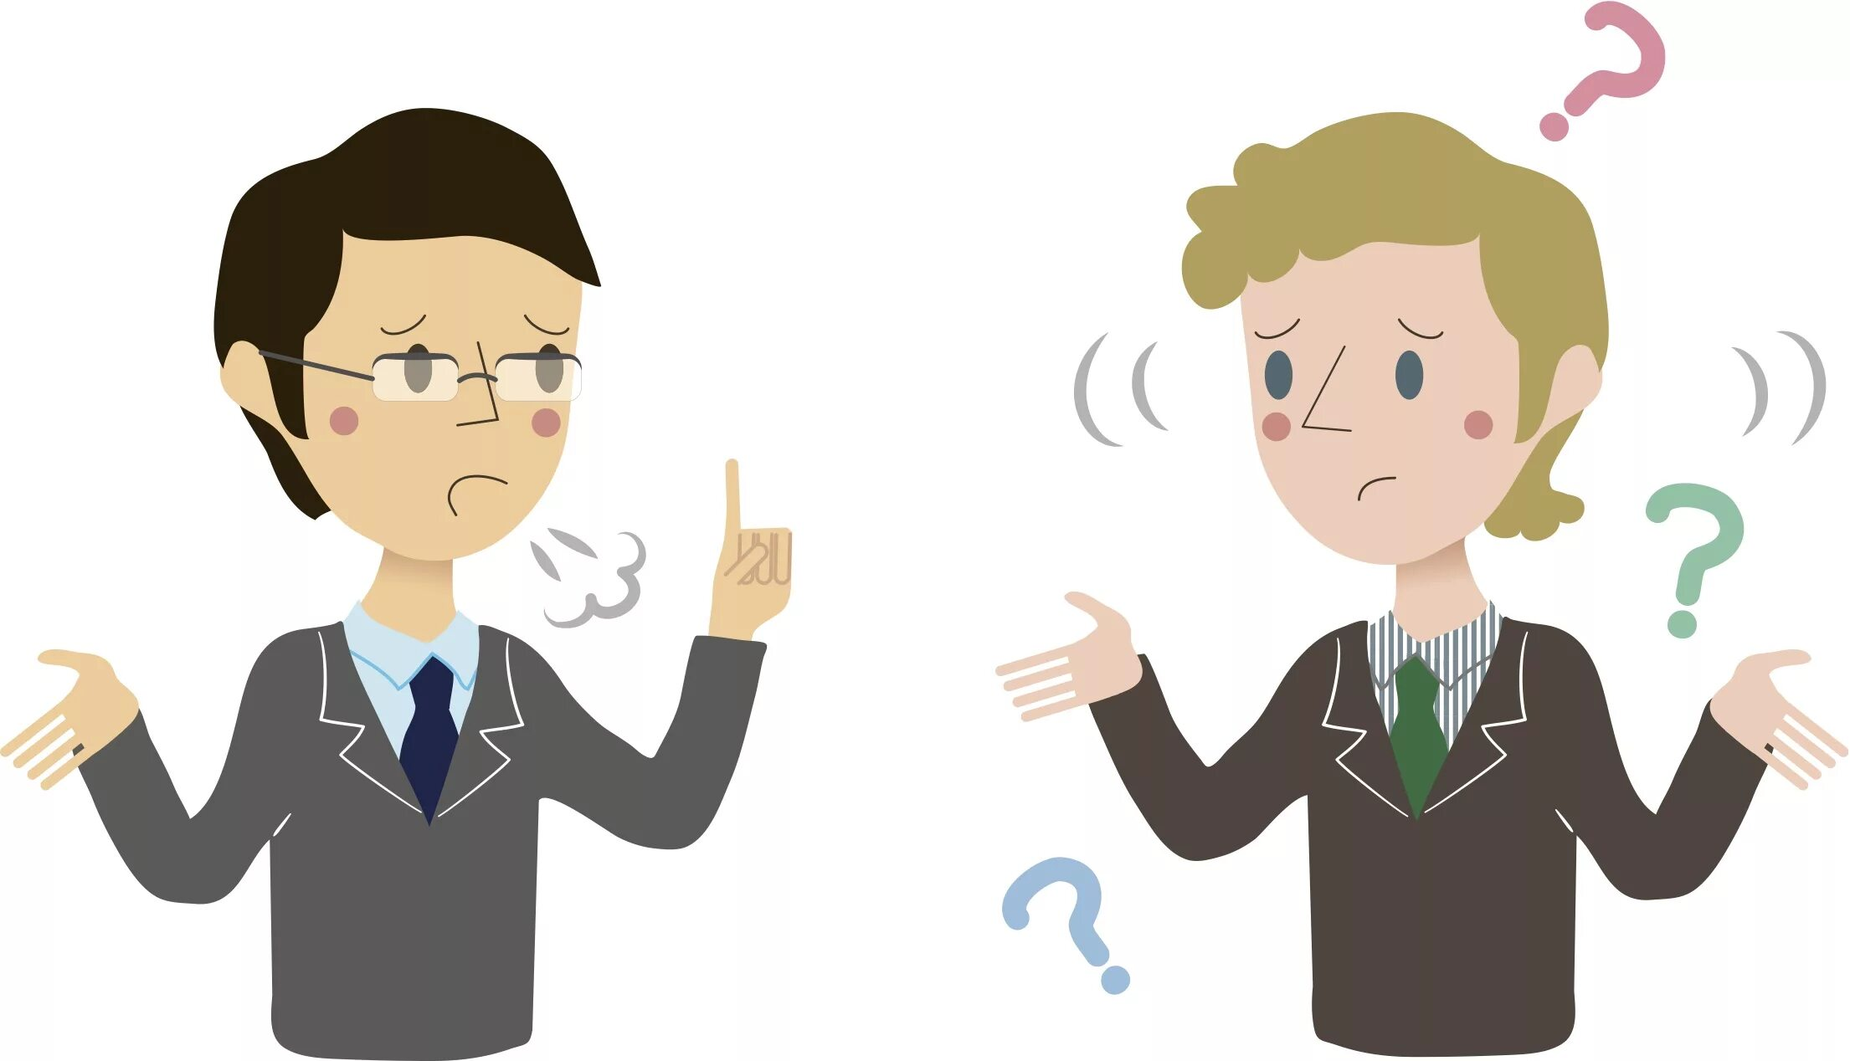

Slide 26
Home task: 1) rule “P.s & P.c”;

